Slide 1
Giving an effective presentation: Using Powerpoint and structuring a scientific talk
based on a presentation at the
2005 Pew Foundation meeting by
Susan McConnell
Department of Biological Sciences
Stanford University

Slide 2
We may not be experts at public speaking, but we are all experts at listening to talks

Slide 3
What do you want from a talk?

Slide 4
Before planning your talk think about its purpose,
the audience you will be talking to, and the setting.
Don’t assume the audience will all be experts.
Never underestimate your audience!
Check on the time that has been allotted to you.
How big is the room?

Slide 5
What do you think of the following slide?

Slide 6
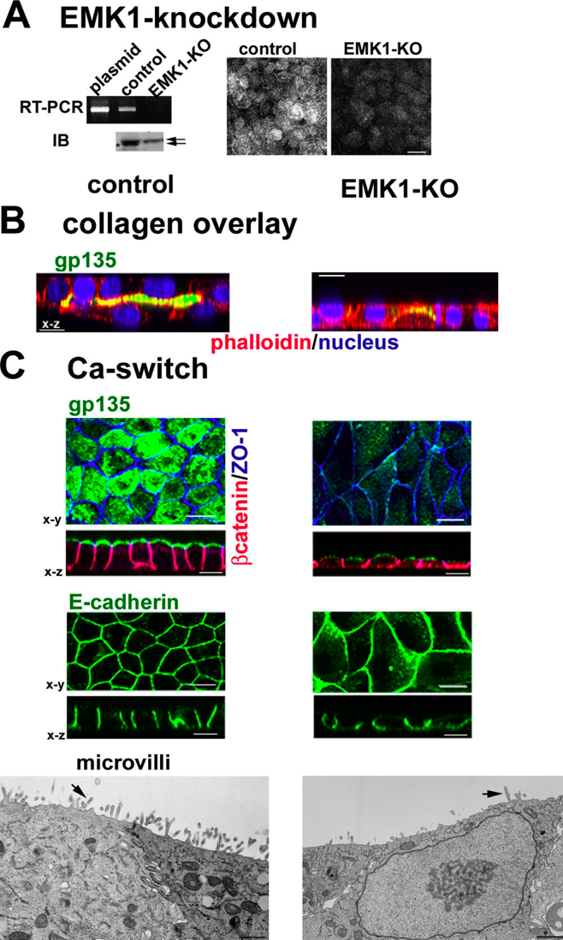
Emk1 knockdown inhibits lumen formation in MDCK cells:
RT-PCR: EMK1 is effectively knocked down in MDCK cells 24 hours after transfection with P-SUPER (control) or P-SUPER-siEMK1 plasmid; knockdown confirmed on the right with antibodies to EMK1.
Collagen overlay assay: cells cultured 24 h on collagen I before being overlaid with additional collagen on the apical surface, analyzed 24 h later. Note the lack of lumen in EMK1-KO cultures.
Ca switch: control or EMK1-KO cells were plated in low Ca medium 24 h upon transfection with pSUPER or pSUPER-KO. After 12 h, cultures were switched to normal medium for 24 h. Transmission EM of cells sectioned perpendicular to the substratum shows lack of microvilli in EMK1-KO cells.

Slide 7
Of course, it is far to confusing and a clear take-home
message does not come across !
This presentation will take you through a strategy for
presenting the data in a clear and logical way.

Slide 8
Powerpoint basics: 1. What font to use
Use a Sans Serif font:
This font is Arial.
This font is Comic Sans.
This font is Papyrus.
Serif fonts take longer to read…
This font is Times New Roman.
This font is Courier.
This font is Didot.

Slide 9
Powerpoint basics: 1. What font to use
Some fonts look really good in boldface:
Arial vs. Arial bold
Comic Sans vs. Comic Sans bold
Papyrus vs. Papyrus bold

Slide 10
Powerpoint basics: 1. What font to use
Type size should be 18 points or larger:
18 point
20 point
24 point
28 point
36 point
* References can be in 14 point font

Slide 11
Powerpoint basics: 1. What font to use
AVOID USING ALL CAPITAL LETTERS BECAUSE IT’S REALLY HARD TO READ!

Slide 12
Powerpoint basics: 2. Color
Dark letters against a light background work.

Slide 13
Powerpoint basics: 2. Color
Light letters against a dark background also work.

Slide 14
Powerpoint basics: 2. Color
Many experts feel that a dark blue or black background works best for talks in a large room.

Slide 15
Powerpoint basics: 2. Color
Dark letters against a light background are best for smaller rooms and for teaching.

Slide 16
Powerpoint basics: 2. Color
Avoid red-green combinations because a significant fraction of the human population is red-green colorblind.

Slide 17
Powerpoint basics: 2. Color
Avoid red-green combinations because a large fraction of the human population is red-green colorblind.
Lots of people can’t read this –
and even if they could, it makes your eyes hurt.

Slide 18
Powerpoint basics: 2. Color
Other color combinations can be equally bad:

Slide 19
Powerpoint basics: 2. Color
View your slides in grayscale to ensure that there is adequate color contrast in each slide.

Slide 20
Powerpoint basics: 3. Layout
Keep the layout and style as consistent as possible
Every slide should have a heading.
Sentences are preferred if it’s possible
to make a statement.

Slide 21
Powerpoint basics: 3. Layout
Limit text blocks to no more than two lines each.

Slide 22
Powerpoint basics: 3. Layout
The reason for limiting text blocks to two lines is that when the text block goes on and on forever, people in the audience are going to have to make a huge effort to read the text, which will preclude them from paying attention to what you are saying. Every time you lose their focus, your presentation suffers!

Slide 23
Powerpoint basics: 3. Layout
Lists should contain no more than 3 items:
• Item 1
• Item 2
• Item 3

Slide 24
Powerpoint basics: 3. Layout
It is often effective to “unveil” your list one by one:
You can do this using the “Slide show” - “animations” -”custom” - option
Point 1
Point 2
Point 3

Slide 25
Powerpoint basics: 3. Layout
Avoid sublists!
• Item 1
Item 1a
Item 1b
Item 1c
• Item 2
- Item 2a
- Item 2b
• Item 3

Slide 26
Powerpoint basics: 3. Layout
Be generous with empty space.

Slide 27
Powerpoint basics: 3. Layout
If you try to cram too much into a slide, and place things too close to the sides, they can get cut off if you’re using a poor projector. In any case, the slide looks all cluttered and junky.

Slide 28
Powerpoint basics: 4. Style
Try your best to include a
simple image on every slide.

Slide 29
Powerpoint basics: 4. Style
Limit the number of items on each slide.
Each slide should make just one or two points!

Slide 30
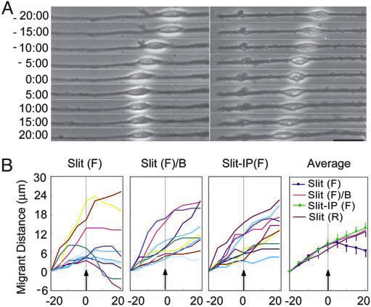
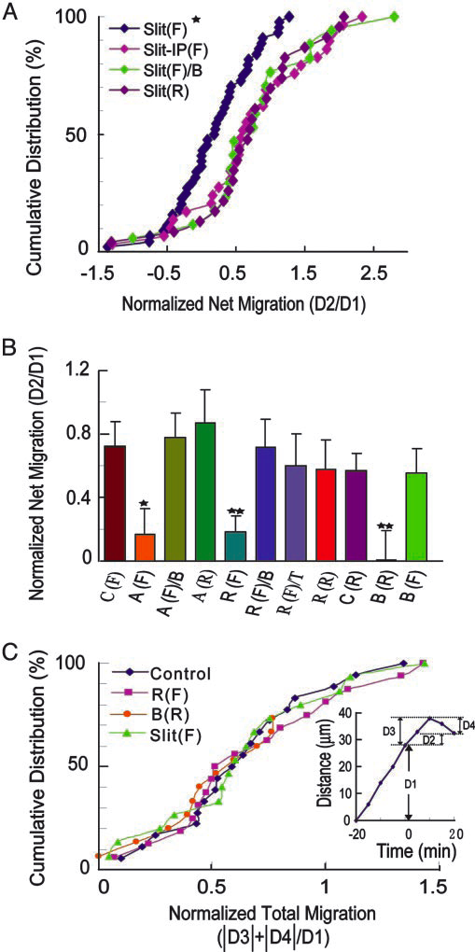
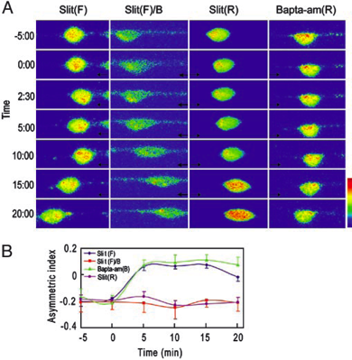
Powerpoint basics: 4. Style
Arrrgh!

Slide 31
Powerpoint basics: 4. Style
Don’t try to show too many slides.
Often, less is more.

Slide 32
It’s very easy to use Powerpoint really badly

Slide 33
Emk1 knockdown inhibits lumen formation in MDCK cells:
RT-PCR: EMK1 is effectively knocked down in MDCK cells 24 hours after transfection with P-SUPER (control) or P-SUPER-siEMK1 plasmid; knockdown confirmed on the right with antibodies to EMK1.
Collagen overlay assay: cells cultured 24 h on collagen I before being overlaid with additional collagen on the apical surface, analyzed 24 h later. Note the lack of lumen in EMK1-KO cultures.
Ca switch: control or EMK1-KO cells were plated in low Ca medium 24 h upon transfection with pSUPER or pSUPER-KO. After 12 h, cultures were switched to normal medium for 24 h. Transmission EM of cells sectioned perpendicular to the substratum shows lack of microvilli in EMK1-KO cells.

Slide 34
It takes some work and forethought to use Powerpoint well

Slide 35
It takes some work and forethought to use Powerpoint well
Let’s break down the previous slide into its minimum essential components

Slide 36
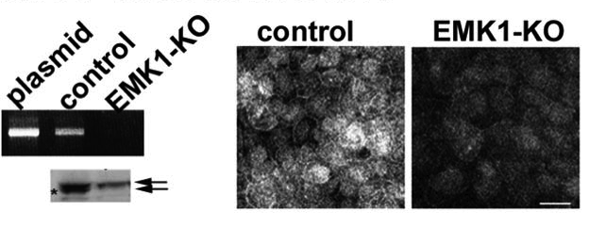
EMK1 / Par1 can be knocked down in MDCK (kidney) cells using siRNA methods
RT-PCR
Western
MDCK (kidney)cells

Slide 37
EMK1 / Par1 can be knocked down in MDCK (kidney) cells using siRNA methods
RT-PCR
Western
MDCK cells

Slide 38
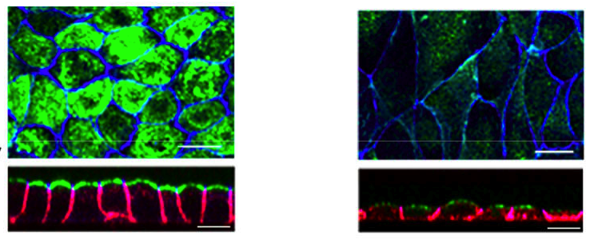
MDCK cells form a lumen following a change in extracellular [Ca⁺⁺ ]
MDCK cells
Surface view from lumen
Side view of lumen
gp135
β-catenin
ZO-1

Slide 39
MDCK cells form a lumen following a change in extracellular [Ca⁺⁺ ]
MDCK cells
Surface view from lumen
Side view of lumen
gp135
β-catenin
ZO-1

Slide 40
Lumen formation is blocked in EMK1 knockdown cells
MDCK cells
EMK1 knockdown
gp135
β-catenin
ZO-1

Slide 41
EMK1 knockdown cells also fail to form microvilli
MDCK cells
EMK1 knockdown

Slide 42
EMK1 knockdown cells also fail to form microvilli
MDCK cells
EMK1 knockdown

Slide 43
The structure of a good talk: start broad, get specific, and end broad

Slide 44
The structure of a good talk: start broad, get specific, and end broad

Slide 45
The structure of a good talk: start broad, get specific, and end broad
Start with the biggest questions and get progressively more specific

Slide 46
A powerful tool in a talk is a “home slide”
Design and introduce a “home slide” that you’ll come back to at each major transition in your talk.

Slide 47
A powerful tool in a talk is a “home slide”
Now we’ll build an introduction and a home slide that puts the previous data into context.

Slide 48
Our bodies are full of tubes

Slide 49
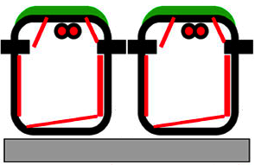
Our bodies are full of tubes
Intestine:
digestive enzymes

Slide 50
How do cells become polarized and form a lumen?
Intestine:
digestive enzymes

Slide 51
MDCK cells are a model system for a polarized cell type (from the kidney)

Slide 52
MDCK cells are highly polarized

Slide 53
MDCK cells are highly polarized
apical proteins

Slide 54
MDCK cells are highly polarized
apical proteins
centrosome

Slide 55
MDCK cells are highly polarized
apical proteins
centrosome
tight junctions

Slide 56
MDCK cells are highly polarized
apical proteins
centrosome
tight junctions
microtubules

Slide 57
MDCK cells are highly polarized
apical proteins
centrosome
tight junctions
microtubules
extracellular matrix

Slide 58
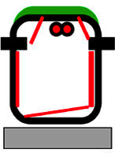
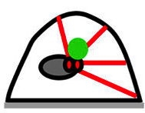
MDCK cells lose their polarity in low [Ca⁺⁺]
low [Ca⁺⁺]

Slide 59
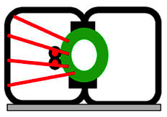
MDCK cells regain their polarity in normal [Ca⁺⁺] and reform a lumen
normal [Ca⁺⁺]

Slide 60
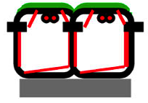
MDCK cells regain their polarity in normal [Ca⁺⁺] and reform a lumen
normal [Ca⁺⁺]
time

Slide 61
Questions addressed today:

Slide 62
Questions addressed today:
• What molecular mechanisms
regulate cell polarization?

Slide 63
Questions addressed today:
• What molecular mechanisms
regulate cell polarization?
• What molecular mechanisms
regulate lumen formation?

Slide 64
Questions addressed today:
• What molecular mechanisms
regulate cell polarization?
• What molecular mechanisms
regulate lumen formation?
• How do different tissues form
different types of tubes?

Slide 65
The structure of a good talk: start broad, get specific, and end broad
The middle is the meat of the talk…

Slide 66
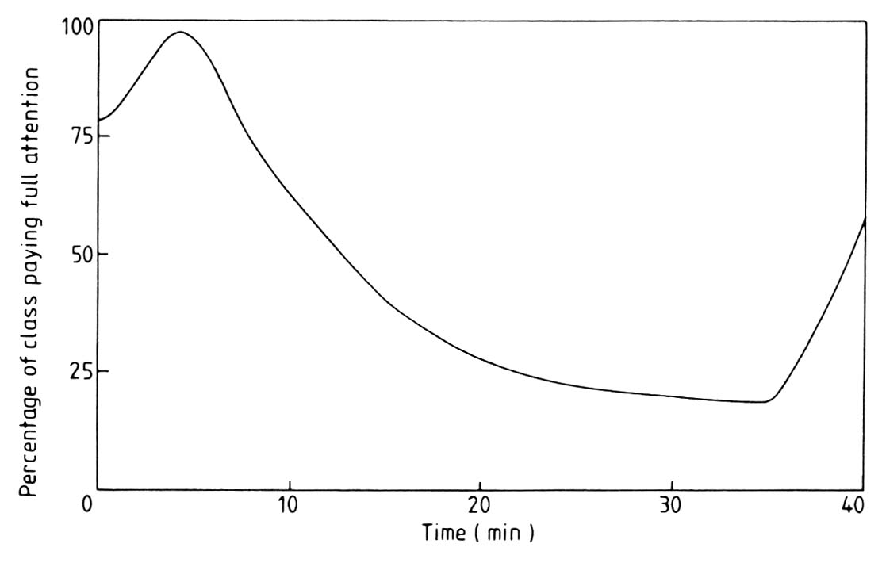
…but talks are delivered to audiences with limited attention spans
Audience attention curve

Slide 67
The structure of a good talk: start broad, get specific, and end broad
The middle is also the time at which the audience tends to zone out

Slide 68
The structure of a good talk: start broad, get specific, and end broad
After going into depth, come back to your home slide to make transitions

Slide 69
The structure of a good talk: start broad, get specific, and end broad
After going into depth, come back to your home slide to make transitions
Nontechnical
General
technical
Specialist

Slide 70
The structure of a good talk: start broad, get specific, and end broad
Let’s review “episode 1” (which we’ve already designed) and add a home slide
Nontechnical
General
technical
Specialist

Slide 71
Questions addressed today:
• What molecular mechanisms
regulate cell polarization?
• What molecular mechanisms
regulate lumen formation?
• How do different tissues form
different types of tubes?

Slide 72
EMK1 (also known as Par1) is a serine-threonine kinase that is essential for cell polarity
EMK1 localizes to tight junctions

Slide 73
EMK1 / Par1 can be knocked down in MDCK (kidney) cells using siRNA methods
RT-PCR
Western
MDCK cells

Slide 74
Lumen formation is blocked in EMK1 knockdown cells
MDCK cells
EMK1 knockdown
gp135
β-catenin
ZO-1

Slide 75
EMK1 knockdown cells also fail to form microvilli
MDCK cells
EMK1 knockdown

Slide 76
EMK1 is required for cell polarization
Normal MDCK cells:
low [Ca⁺⁺]
normal [Ca⁺⁺]

Slide 77
EMK1 is required for cell polarization
EMK1 knockdown cells:
low [Ca⁺⁺]
normal [Ca⁺⁺]

Slide 78
Use your home slide repeatedly to build a theme over time and enable the audience to catch up
home slide
Nontechnical
General
technical
Specialist

Slide 79
Over the course of the talk, you can progressively build a fairly complex model
final home slide
Nontechnical
General
technical
Specialist

Slide 80
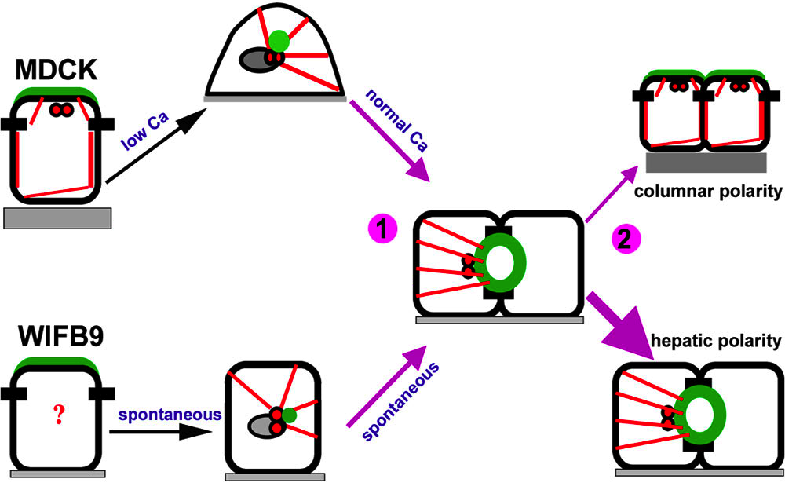
EMK1 regulates microtubules and cell polarity in two steps

Slide 81
The structure of a good talk: start broad, get specific, and end broad
Focus now on conclusions

Slide 82
Audience attention increases as you signal the end of the talk – so avoid false endings!
Audience attention curve

Slide 83
The structure of a good talk: start broad, get specific, and end broad
End with the most specific conclusions then build back out to the “big picture”

Slide 84
EMK1 regulates microtubules and cell polarity in two steps

Slide 85
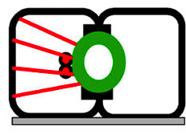
EMK1 can regulate the type of lumen formed by epithelial cells
Intestine: Liver:
digestive enzymes bile

Slide 86
This enables the body to make many different types of tubes in different organs
Intestine: Liver:
digestive enzymes bile

Slide 87
Organizing a great talk
• Be smart about Powerpoint

Slide 88
Organizing a great talk
• Be smart about Powerpoint
• Your introduction should
start broad then get specific

Slide 89
Organizing a great talk
• Be smart about Powerpoint
• Your introduction should
start broad then get specific
• Think of your talk as
consisting of episodes

Slide 90
Organizing a great talk
• Be smart about Powerpoint
• Your introduction should
start broad then get specific
• Think of your talk as
consisting of episodes
• Use a home slide to make
transitions effectively

Slide 91
Organizing a great talk
• Be smart about Powerpoint
• Your introduction should
start broad then get specific
• Think of your talk as
consisting of episodes
• Use a home slide to make
transitions effectively
• Your conclusion should start
specific but end broadly

Slide 92
There is more to giving a good talk than showing good slides
Do face the audience and make eye contact Do be enthusiastic and vary the tone of your voice, Don’t pace up and down but also don’t stand rigid! Don’t wave your pointer all over the slide Don’t take lots of drinks- it is distracting and unprofessional

Slide 93
There is more to giving a good talk than showing good slides
Do practice beforehand, preferably using a video camera and timer Do ask your friends (and family) for feedback Don’t use too many gimmicks

Slide 94
Here are some of the things many listeners want from a talk:

Slide 95
A great resource is
The Craft of Scientific Presentations
by Michael Alley

